Slide 1
Car Object Detection With DETR
CS496 2022-2023_Project team#6

Slide 2
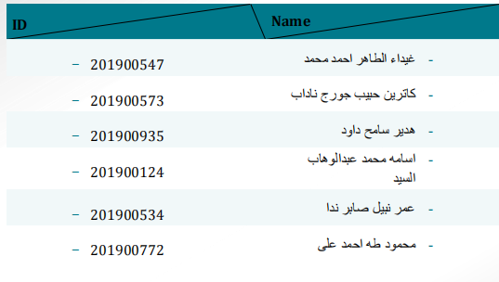
Team Members

Slide 3

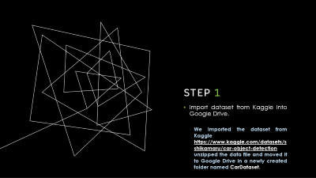
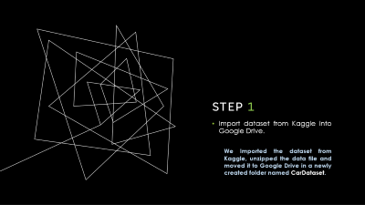
Defining Our Project Step-by-Step
Step1: Import dataset from Kaggle into Google Drive.
Step2: Split annotations into train-validation sub _ sets.
Step3: Change annotations file format to COCO file format.
Step4: Clone DETR Repository from GitHub.
Step5: Load training data into DETR with desired format.
Step6: Load DETR model with backbone ResNet50 pre-trained weights.
Step7: Train DETR and save model checkpoints.
Step8: Evaluate and test custom trained model on testing data.

Slide 4
Step 1
Import dataset from Kaggle into Google Drive.
We Imported the dataset from Kaggle https://www.kaggle.com/datasets/sshikamaru/car-object-detection unzipped the data file and moved it to Google Drive in a newly created folder named CarDataset.

Slide 5
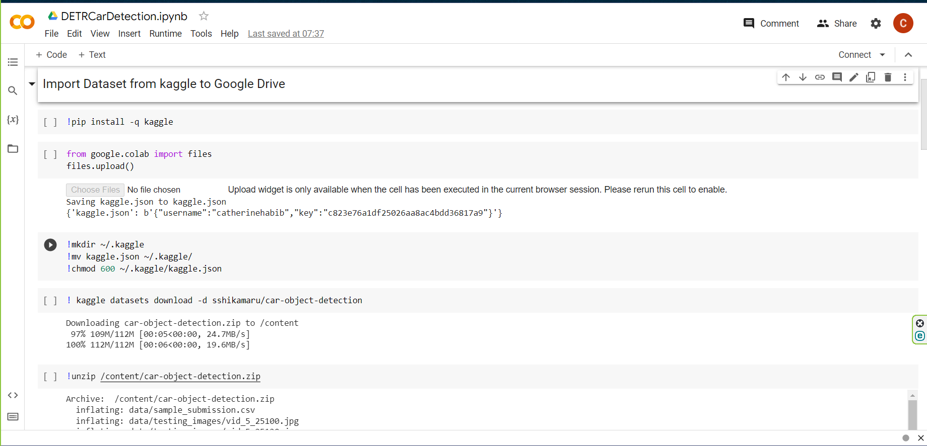
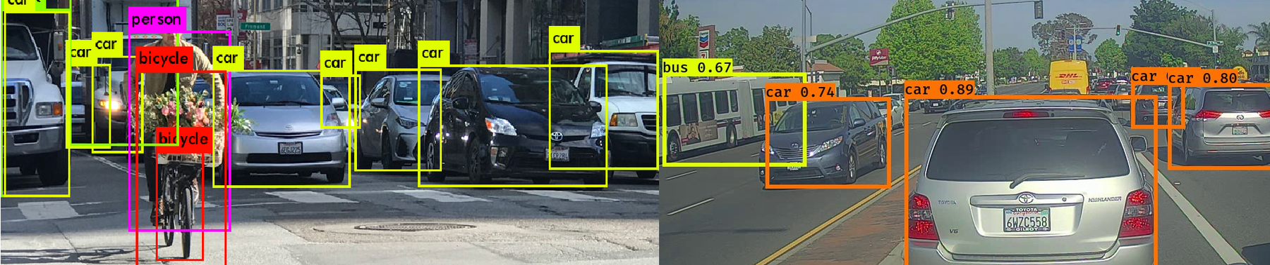
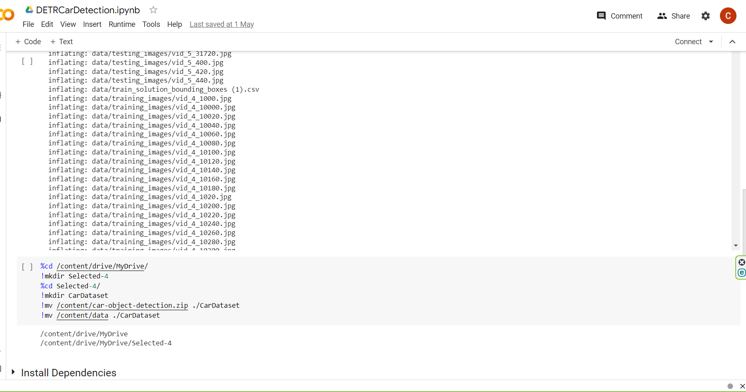
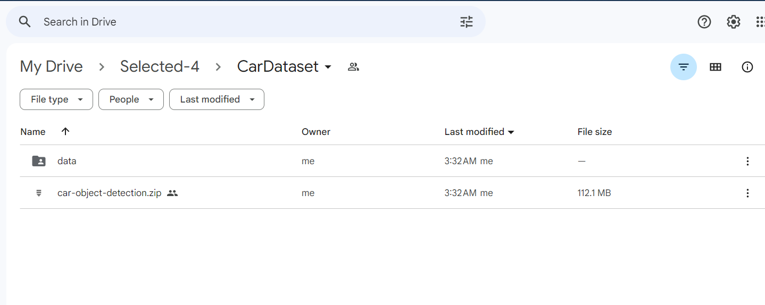
Kaggle |car-object-detection Dataset by - EDWARD ZHANG
Code on Colaboratory Notebook
Files on Google Drive

Slide 6
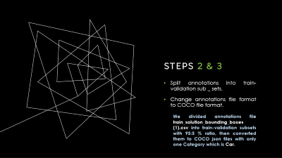
Defining Our Project Step-by-Step
Step1: Import dataset from Kaggle into Google Drive.
Step2: Split annotations into train-validation sub _ sets.
Step3: Change annotations file format to COCO file format.
Step4: Clone DETR Repository from GitHub.
Step5: Load training data into DETR with desired format.
Step6: Load DETR model with backbone ResNet50 pre-trained weights.
Step7: Train DETR and save model checkpoints.
Step8: Evaluate and test custom trained model on testing data.

Slide 7
Steps 2 & 3
Split annotations into train-validation sub _ sets.
Change annotations file format to COCO file format.
We divided annotations file train_solution_bounding_boxes (1).csv into train-validation subsets with 95:5 % ratio, then converted them to COCO json files with only one Category which is Car.

Slide 8
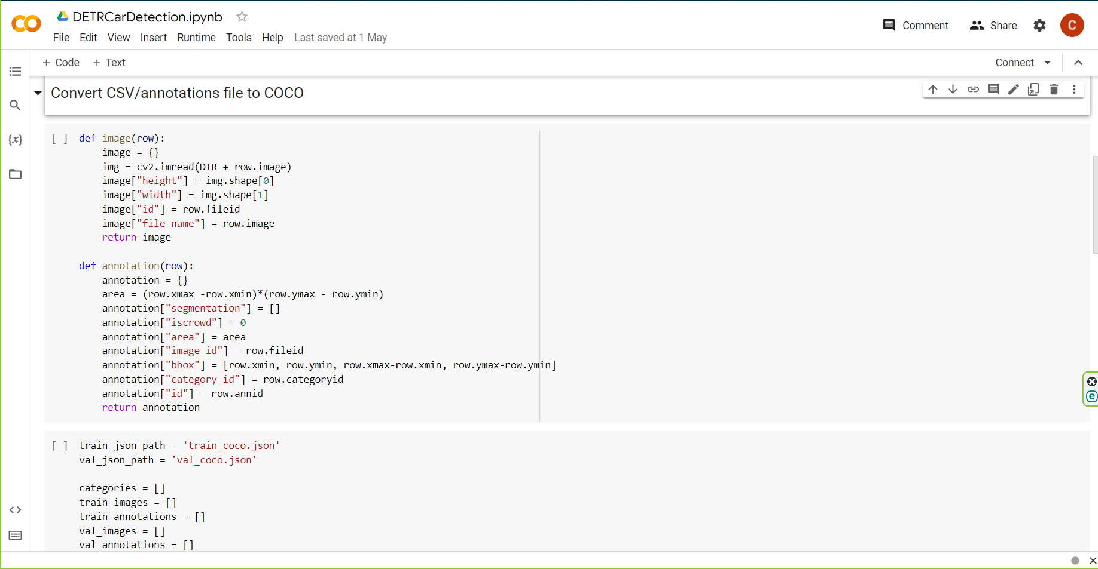
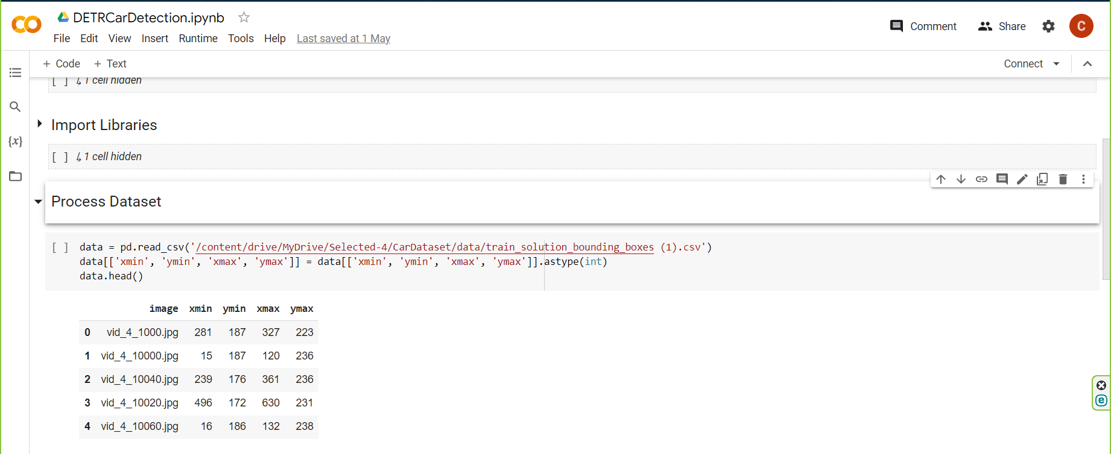
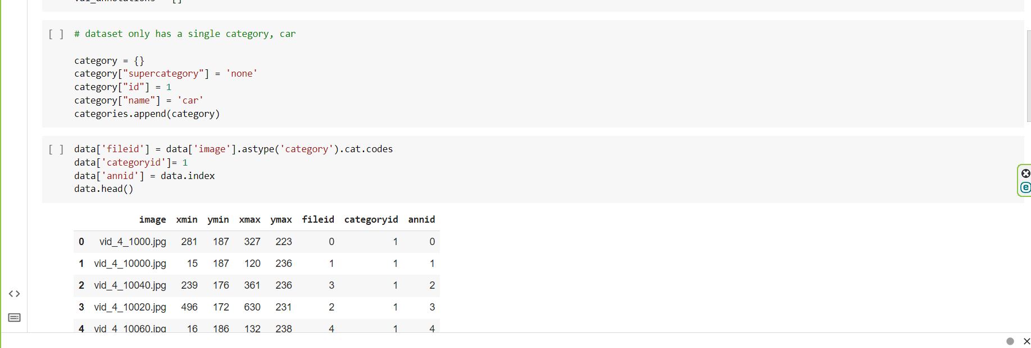
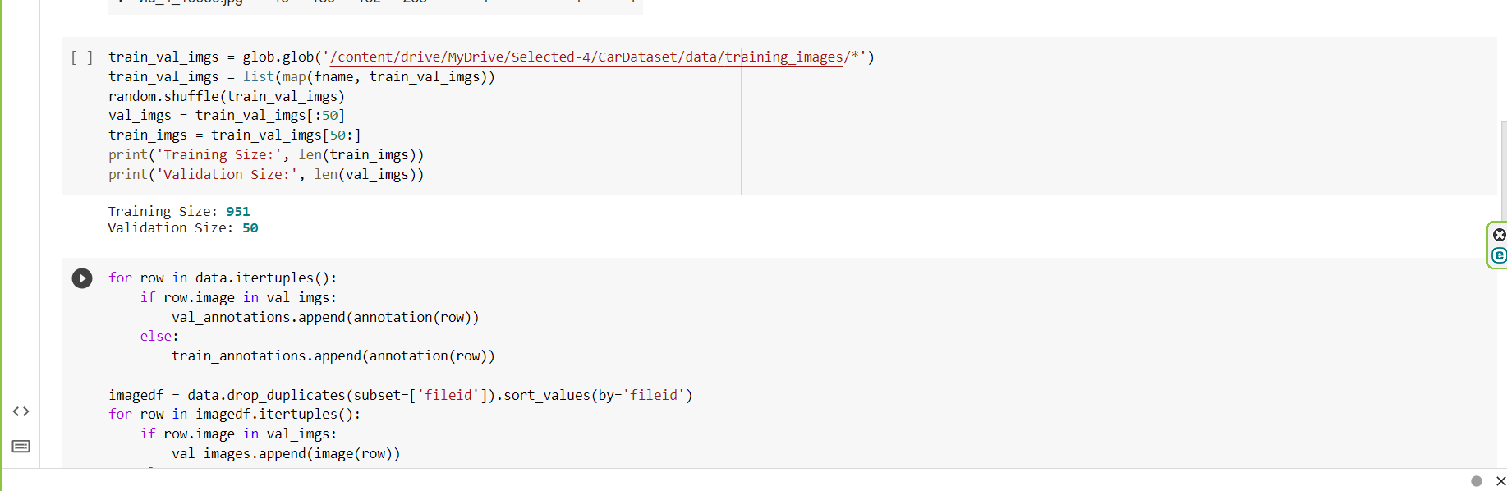
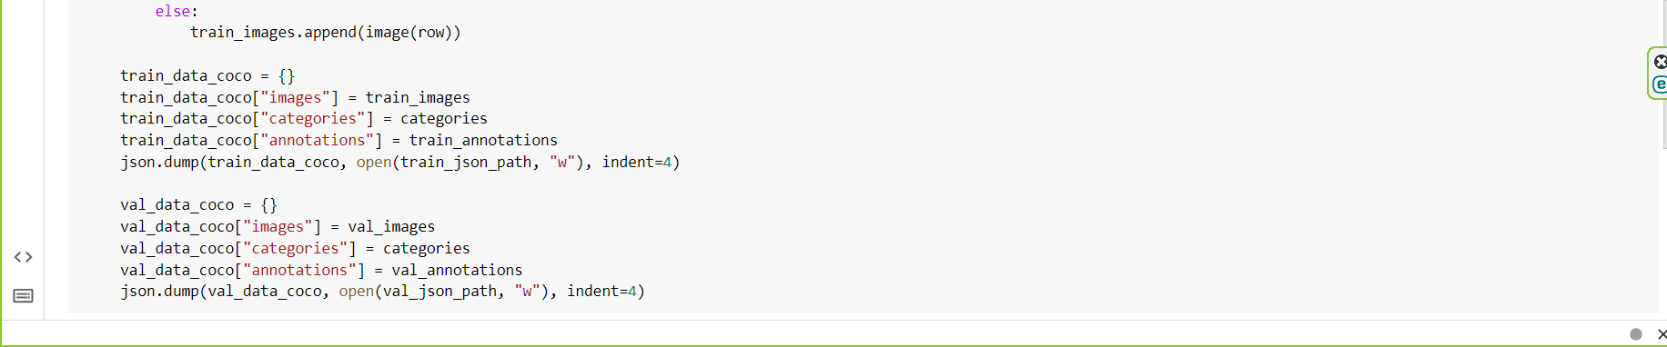
We had to add more fields to the csv file in order to convert it to json format such as fileid, annid and categoryid.
Original csv
Code on Colaboratory Notebook
Save json files to current runtime

Slide 9
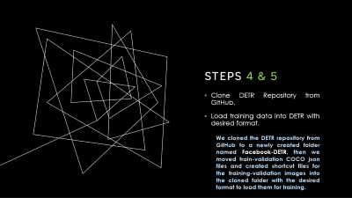
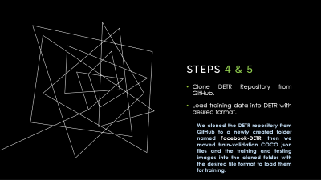
Defining Our Project Step-by-Step
Step1: Import dataset from Kaggle into Google Drive.
Step2: Split annotations into train-validation sub _ sets.
Step3: Change annotations file format to COCO file format.
Step4: Clone DETR Repository from GitHub.
Step5: Load training data into DETR with desired format.
Step6: Load DETR model with backbone ResNet50 pre-trained weights.
Step7: Train DETR and save model checkpoints.
Step8: Evaluate and test custom trained model on testing data.

Slide 10
Steps 4 & 5
Clone DETR Repository from GitHub.
Load training data into DETR with desired format.
We cloned the DETR repository from GitHub to a newly created folder named Facebook-DETR, then we moved train-validation COCO json files and created shortcut files for the training-validation images into the cloned folder with the desired format to load them for training.

Slide 11
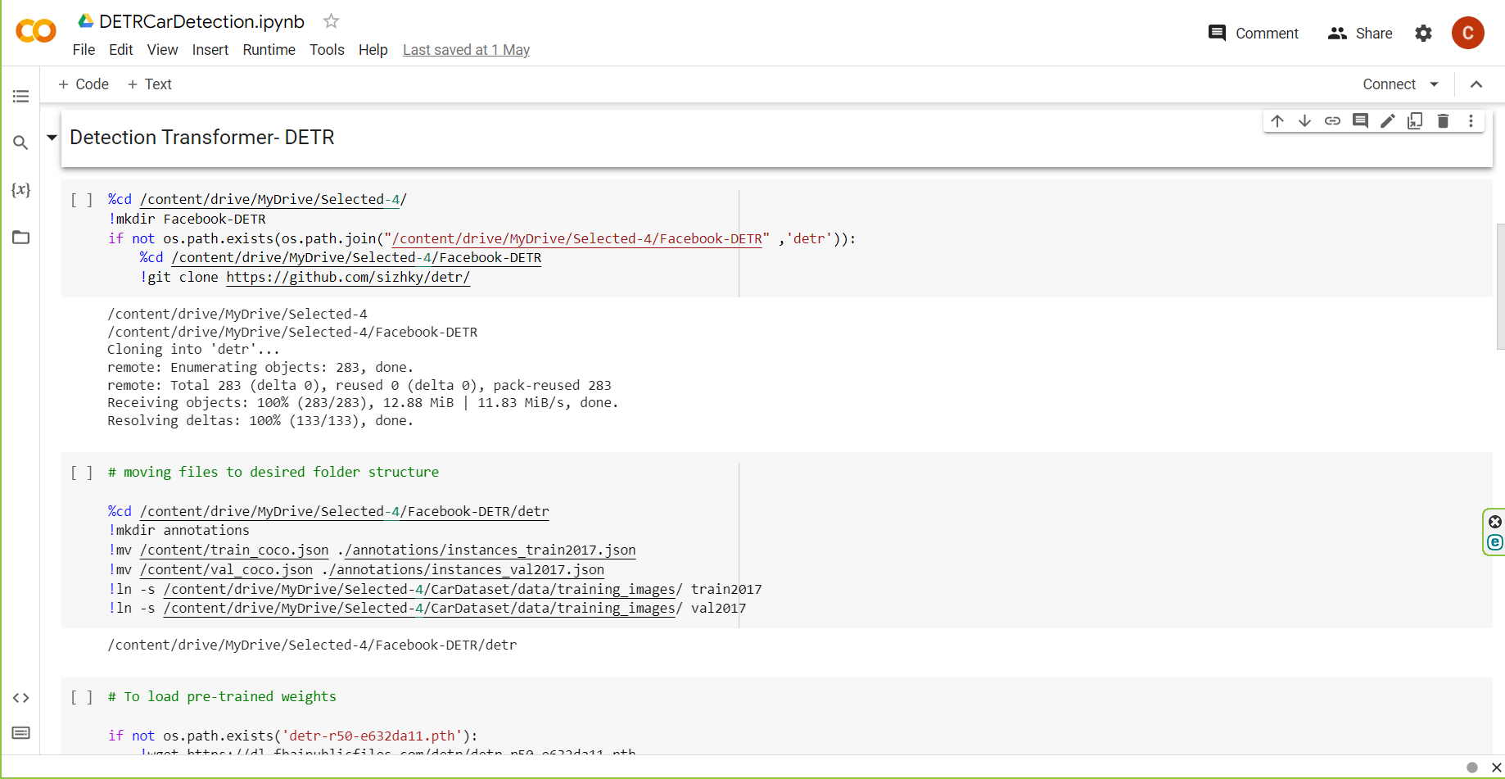
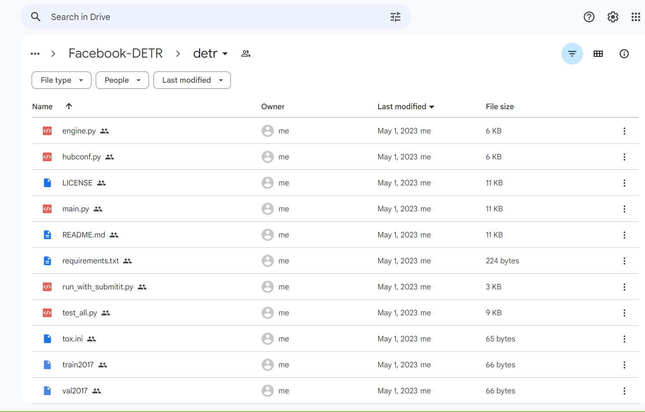
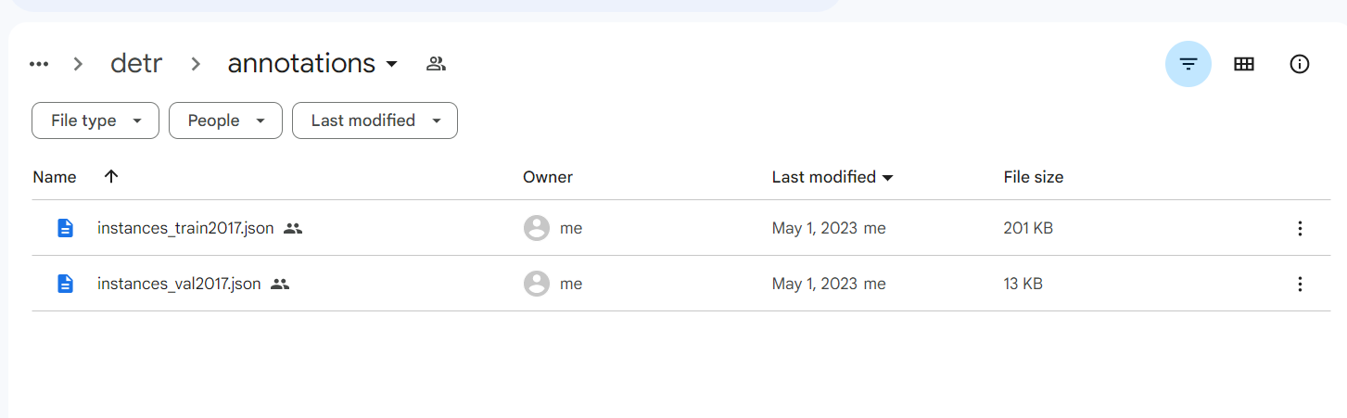
We had to rename our files with the same names as COCO dataset files and move them to the desired file structure to load them later for training.
We created a folder for annotations into detr folder and moved them there renamed as instances_train2017.json and instances_val2017.json.
We also created a shortcut for training-validation images with two files and moved them into detr folder under the names of train2017 and val2017.
Code on Colaboratory Notebook
images
… ..
annotations

Slide 12
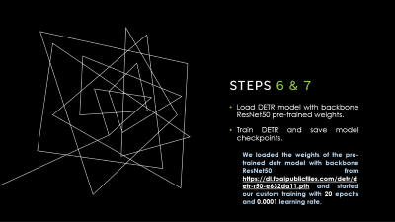
Defining Our Project Step-by-Step
Step1: Import dataset from Kaggle into Google Drive.
Step2: Split annotations into train-validation sub _ sets.
Step3: Change annotations file format to COCO file format.
Step4: Clone DETR Repository from GitHub.
Step5: Load training data into DETR with desired format.
Step6: Load DETR model with backbone ResNet50 pre-trained weights.
Step7: Train DETR and save model checkpoints.
Step8: Evaluate and test custom trained model on testing data.

Slide 13
Steps 6 & 7
Load DETR model with backbone ResNet50 pre-trained weights.
Train DETR and save model checkpoints.
We loaded the weights of the pre-trained detr model with backbone ResNet50 from https://dl.fbaipublicfiles.com/detr/detr-r50-e632da11.pth and started our custom training with 20 epochs and 0.0001 learning rate.

Slide 14
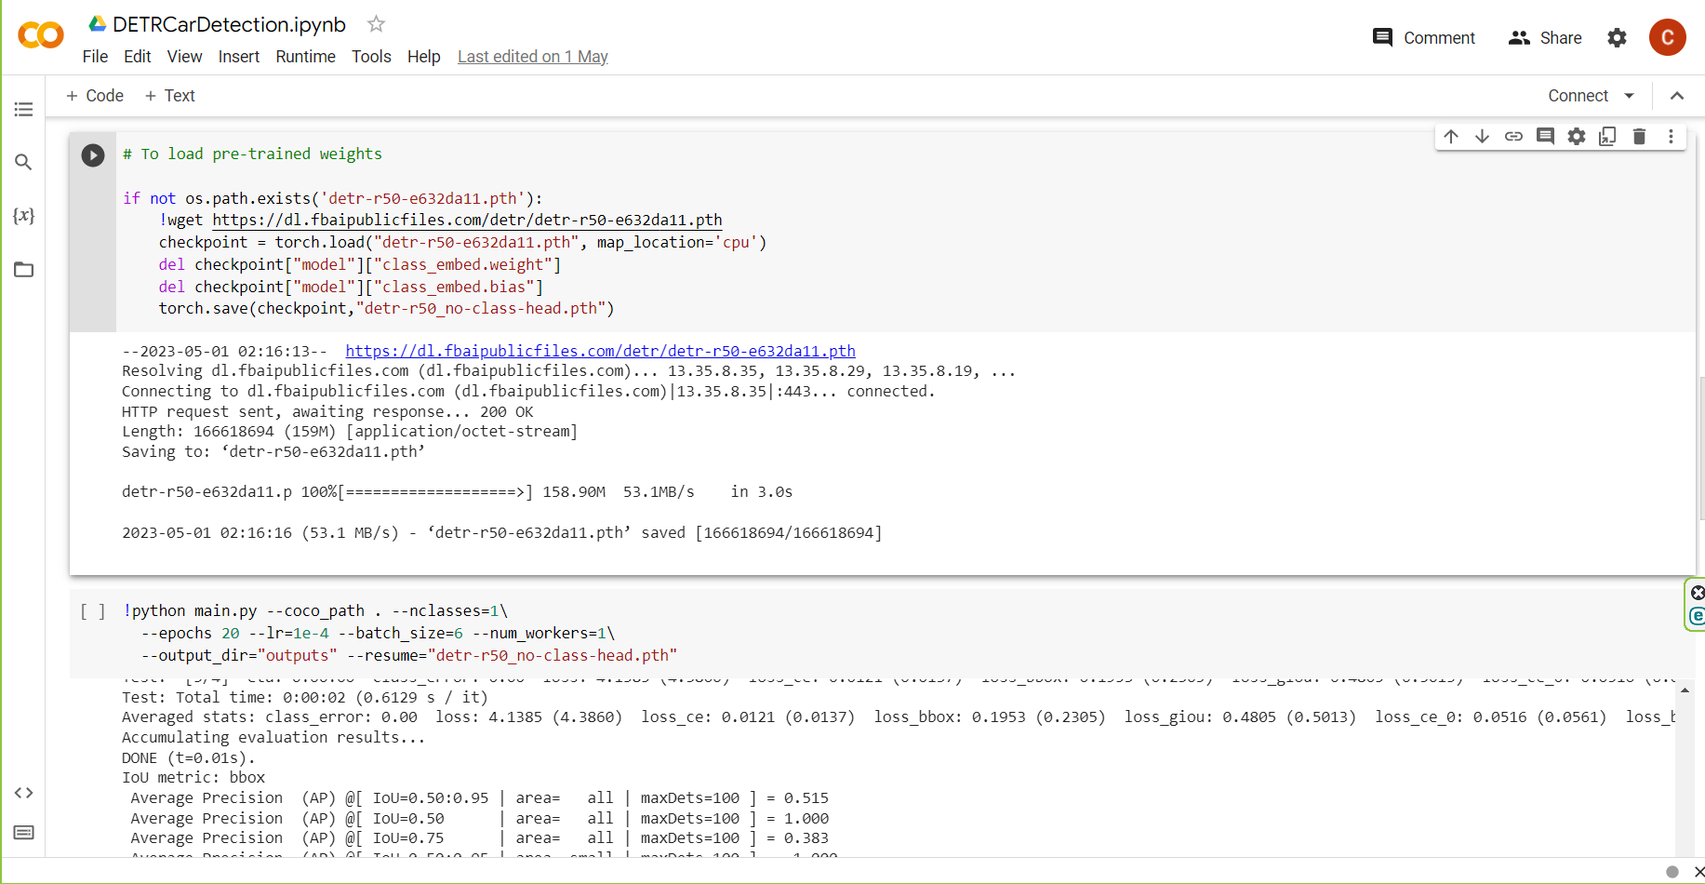
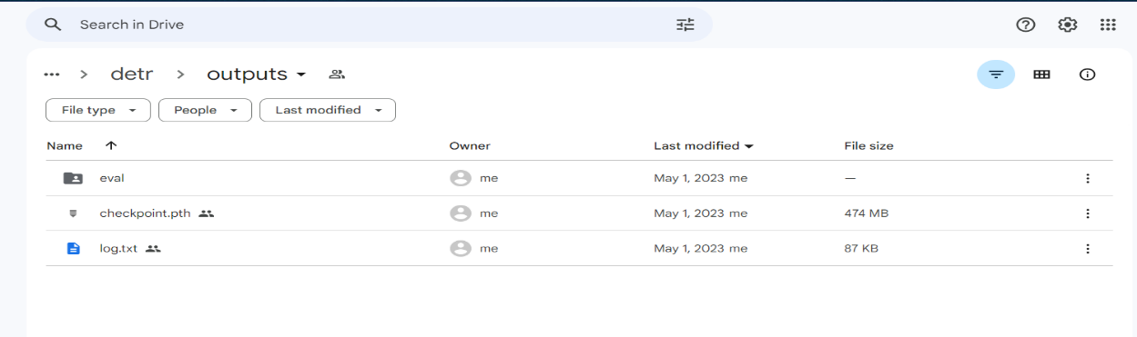
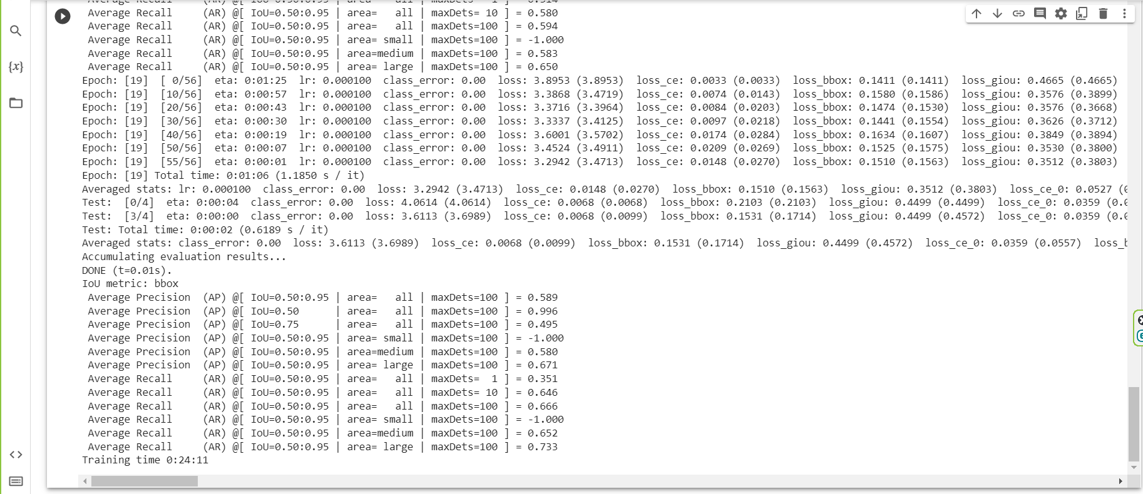
We trained our model for 0:24:11 mins with one GPU provided by Google Colaboratory, then we saved the model in outputs folder that we created in the cloned detr folder .
Outputs file
Code on Colaboratory Notebook

Slide 15
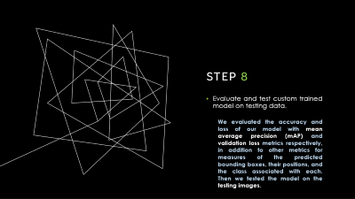
Defining Our Project Step-by-Step
Step1: Import dataset from Kaggle into Google Drive.
Step2: Split annotations into train-validation sub _ sets.
Step3: Change annotations file format to COCO file format.
Step4: Clone DETR Repository from GitHub.
Step5: Load training data into DETR with desired format.
Step6: Load DETR model with backbone ResNet50 pre-trained weights.
Step7: Train DETR and save model checkpoints.
Step8: Evaluate and test custom trained model on testing data.

Slide 16
Step 8
Evaluate and test custom trained model on testing data.
We evaluated the accuracy and loss of our model with mean average precision (mAP) and validation loss metrics respectively, in addition to other metrics for measures of the predicted bounding boxes, their positions, and the class associated with each. Then we tested the model on the testing images.

Slide 17
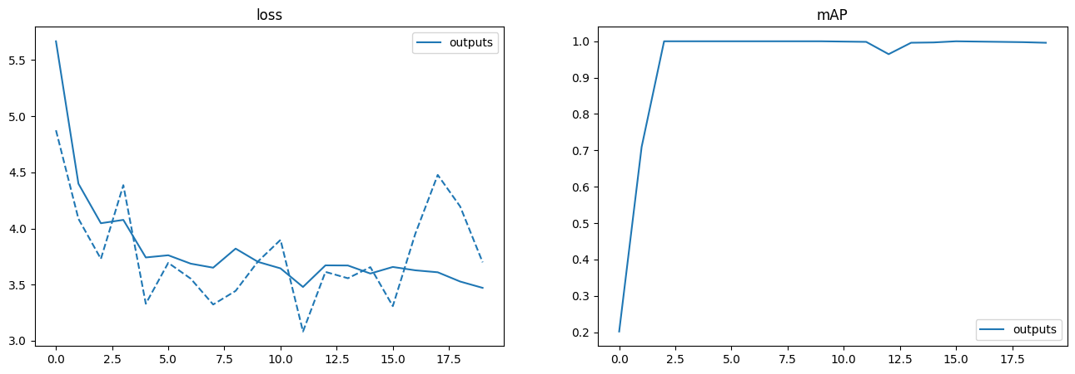
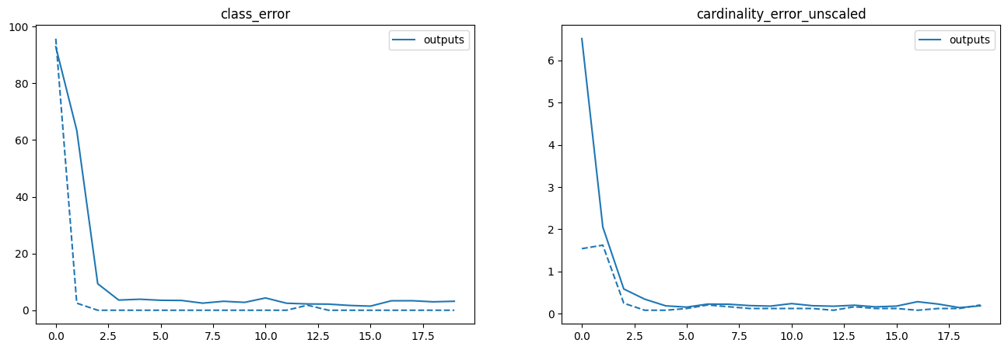
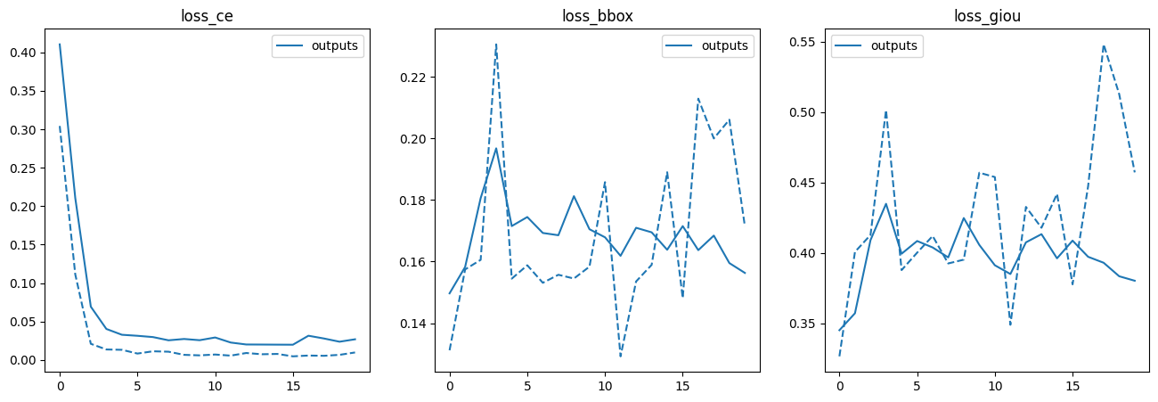
Evaluation with mean average precision mAP and validation loss metrics.
Other metrics related to evaluating class predictions.
Evaluation with cross entropy loss loss_ce, loss of bounding box loss_bbox and generalized intersection over union loss loss_giou metrics.

Slide 18
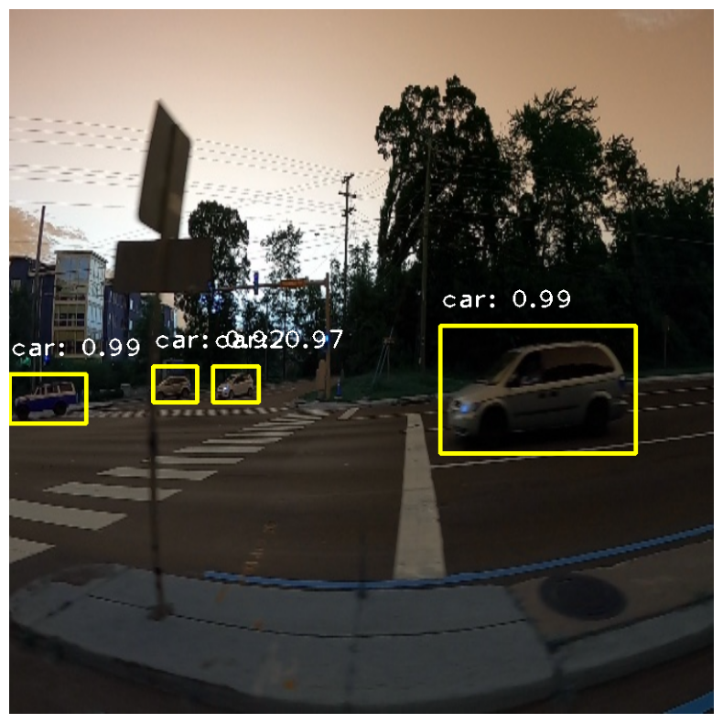
Thank You !
Predictions on testing images.

